Slide 1

Bicycles
Accident
Analysis
by Michael Rusin

Slide 2

102 people
… are killed in a car accident
per day!*
* https://en.wikipedia.org/wiki/Motor_vehicle_fatality_rate_in_U.S._by_year

Slide 3
Introduction (business problem)
This report will try to analyze the best location and time for cycling activities. This project is aimed at individuals interested in cycling activities such as solo cyclists, cycling communities and companies / sponsors / organizers of cycling events.
During a pandemic, many people choose cycling as an alternative to indoor gyms. Cycling is considered the safest way to stay fit due to minimal contact with other people. Unfortunately, there are many road accidents involving cyclists. Cyclists need safety while driving. In the event of an accident, car drivers are protected by car frames and other safety technologies. Their chances of dying or seriously injuring themselves are relatively low compared to cyclists. Cyclists are protected only by a helmet on the head. In the event of an accident, a person's head, legs, hands and other parts of the body are potentially injured.
The project could help the Seattle Department of Transportation (SDOT) install various road signs for cyclists in crash-prone areas. Also, this project will help the cyclist community ^{(*1)}, for example, Cascade Bicylcle Club, COGS (Cyclists Of Greater Seattle), Brake the Cycle, etc., determine the right time for cycling events.
Communities such as the Cascade Bicycle Club host many major cycling events^{(*2)} such as Chilly Hilly, Seattle Bike-n-Brews, Ride for Major Taylor, Flying Wheels Summer Century, Woodinville Wine Ride, Seattle Night Ride, the Red-Bell 100, Seattle to Portland (STP), Ride from Seattle to Vancouver and Party (RSVP), Ride Around Washington (RAW), High Pass Challenge (HPC), and Kitsap Color Classic (KCC).
This project can help companies, sponsors, and event organizers to create safe cycling events for all participants.
^{*1} http://wabikes.org/growing-bicycling/resources/bike-clubs-in-washington-state/
^{*2} https://en.wikipedia.org/wiki/Cascade_Bicycle_Club#Major_events
3

Slide 4
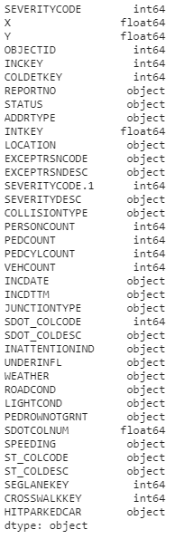
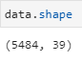
Data understanding
The original dataset can be found here:
https://s3.us.cloud-object-storage.appdomain.cloud/cf-courses-data/CognitiveClass/DP0701EN/version-2/Data-Collisions.csv
Based on definition of our problem, features or columns that will influence our analysis are:
1. Location: Latitude (X), Longitude (Y), Address Type (ADDRTYPE)
2. Severity: A code that corresponds to the severity of the collision (SEVERITYCODE), a detailed description of the severity of the collision (SEVERITYDESC)
3. Person Count: Total number of people involved (PERSONCOUNT), number of bicycles involved in the collision (PEDCYLCOUNT)
4. Date: The date and time of the incident (INCDTTM)
5. Condition: Description of the weather conditions (WEATHER), condition of the road (ROADCOND), light conditions during the collision (LIGHTCOND)
Conditional Selection — Only show data that bicycles involved in the collision
In the explanation of the problem above, we will help solve the problem for cyclists. We limit data on car accidents involving cyclists. So the PEDCYLCOUNT column must be greater than zero.
DataFrame Shape
The dataset used is (5484 rows, 38 columns). Not all columns will be used, will be selected according to the data description above.
DataFrame Data Type and Missing Values
In the description below, we will know the data types and missing values and their presentations.
4

Slide 5
Methodology
1. Data sampling
In this project, not all dataset data are used, but only those that are needed.
2. Working with missing data
Missing values ​​negatively affect forecasting and analysis results. We need to handle missing values ​​by deleting or filling them in. If there are not many missing values, we can consider removing them.
3. Removing duplicates
Duplicate values ​​also negatively affect the results. We need to determine the number of duplicate records and remove them.
4. Convert 'INCDTTM' Column to Datetime Type
The 'ICDDTM' column needs to be converted to DateTime to extract the hour, day, month and year later. We will need this data for a deeper analysis.
5. Exploratory Data Analysis (EDA)
After clearing the data, we can begin our research - finding the best time and place for cycling activities.
The data will be explored and analyzed based on time-related data such as hour, day, month, year and weather. The data is visualized to get an idea of the best place and time for a cycling event. The data visualization includes road conditions, light conditions, and address types.
6. Model Building
The machine learning model used in this project is logistic regression. Why Use Logistic Regression? First, the data is binary. Second, we need probabilistic results to determine the time and place conditions that are most likely to cause an encounter with trauma.
5

Slide 6
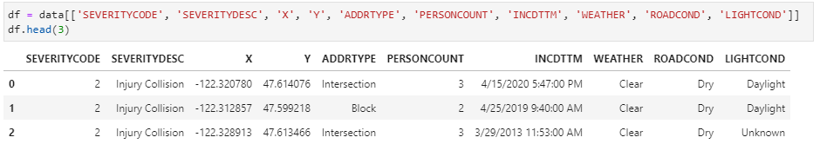
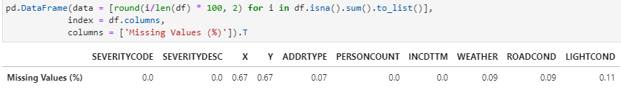
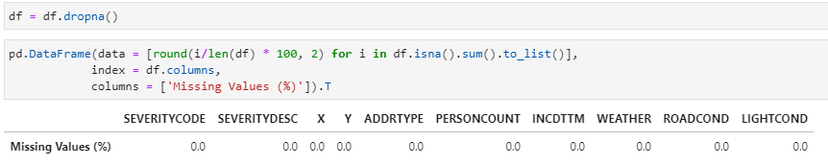
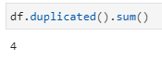
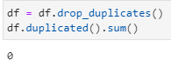
Analysis
Data sampling
We use features that give support to solve the problems that have been planned..
Working with missing data
In the table below, we can see that the missing values ​​in all features are below 1 per cent.
Because the missing values are minimal (less than 1 per cent), we can decide to delete the missing values in all features.
Removing duplicates
We also need to check the data if there is duplicate data. Many duplicate values will affect the analysis and prediction results. Therefore we need to detect the amount of duplicate data. Then we delete the duplicate value.
In the output above, there are four duplicate data. After that, we drop these duplicate values ​​from the dataset. So, we get a cleaner dataset for analysis.
6

Slide 7
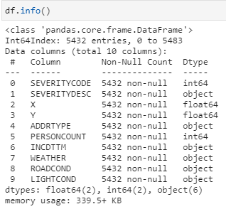
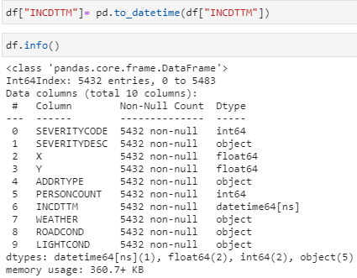
Analysis
Convert ‘INCDTTM’ Column to Datetime Type
Below, we can see that the 'INCDTTM' Column type is still an 'object’.
After changing to DateTime type, column 'INCDTTM' changes to 'datetime64.
After converting to 'datetime64', we can extract the data into new columns such as hour, day, month, and year.
7

Slide 8
Analysis (time)
Exploratory Data Analysis (EDA)
This exploratory data analysis is divided into two parts:
1) Time Analysis, which explores a dataset using time-related attributes.
2) Location Analysis, which explores a dataset using attributes related to roads, lights, and location.
Time Analysis
In the visualization below, the hour variable is not related to the variable number of people involved in the collision.
Hour Variable
When tested for the correlation between hours and number of people involved, the score is only 0.004. This figure is shallow to qualify for a correlation (0.5).
8

Slide 9
Analysis (time)
Day Variable
Below, visualize the total number of people involved in a collision by day and severity type.
Below, a boxplot visualizes the distribution of the number of people involved in the collision by day. In this boxplot, we can also see the outliers in each data. The outlier data on Wednesday has the most considerable value in the data.
9

Slide 10
Analysis (time)
Month Variable
Below, a boxplot visualizes the distribution of the number of people involved in the collision by month. In this boxplot, we can also see the outliers in each data. The outlier data on June has the most considerable value in the data.
Weather Variable
Below, a boxplot visualizes the distribution of the number of people involved in the collision by weather. In this boxplot, we can also see the outliers in each data.The outlier data on Clear weather has the most considerable value in the data.
10

Slide 11
Analysis (location)
Address Type Variable
Below, a boxplot visualizes the distribution of the number of people involved in the collision by address type. In this boxplot, we can also see the outliers in each data. The outlier data on Intersection has the most considerable value in the data.
Road Condition Variable
Below, a boxplot visualizes the distribution of the number of people involved in the collision by road condition. In this boxplot, we can also see the outliers in each data. The outlier data on Dry condition has the most considerable value in the data.
11

Slide 12
Analysis (location)
Light Condition Variable
Below, a boxplot visualizes the distribution of the number of people involved in the collision by light condition. In this boxplot, we can also see the outliers in each data. The outlier data on Daylight condition has the most considerable value in the data.
Seattle road accident map involving cyclists
The map was created with Folium. Using latitude and longitude data, we can visualize the number of cyclist crashes in Seattle.
12

Slide 13
Analysis (model building)
Model Building
What is Logistic Regression?
In statistics, the logistic model (or logit model) is used to model the probability of a certain class or event existing such as pass/fail, win/lose, alive/dead or healthy/sick. This can be extended to model several classes of events such as determining whether an image contains a cat, dog, lion, etc. Each object being detected in the image would be assigned a probability between 0 and 1, with a sum of one.
Logistic regression is a statistical model that in its basic form uses a logistic function to model a binary dependent variable, although many more complex extensions exist. In regression analysis, logistic regression (or logit regression) is estimating the parameters of a logistic model (a form of binary regression). Mathematically, a binary logistic model has a dependent variable with two possible values, such as pass/fail which is represented by an indicator variable, where the two values are labeled "0" and "1".
In the logistic model, the log-odds (the logarithm of the odds) for the value labeled "1" is a linear combination of one or more independent variables ("predictors"); the independent variables can each be a binary variable (two classes, coded by an indicator variable) or a continuous variable (any real value). The corresponding probability of the value labeled "1" can vary between 0 (certainly the value "0") and 1 (certainly the value "1"), hence the labeling; the function that converts log-odds to probability is the logistic function, hence the name. The unit of measurement for the log-odds scale is called a logit, from logistic unit, hence the alternative names.
Analogous models with a different sigmoid function instead of the logistic function can also be used, such as the probit model; the defining characteristic of the logistic model is that increasing one of the independent variables multiplicatively scales the odds of the given outcome at a constant rate, with each independent variable having its own parameter; for a binary dependent variable this generalizes the odds ratio.
13

Slide 14
Analysis (model building)
In a binary logistic regression model, the dependent variable has two levels (categorical). Outputs with more than two values are modeled by multinomial logistic regression and, if the multiple categories are ordered, by ordinal logistic regression (for example the proportional odds ordinal logistic model). The logistic regression model itself simply models probability of output in terms of input and does not perform statistical classification (it is not a classifier), though it can be used to make a classifier, for instance by choosing a cutoff value and classifying inputs with probability greater than the cutoff as one class, below the cutoff as the other; this is a common way to make a binary classifier. The coefficients are generally not computed by a closed-form expression, unlike linear least squares. The logistic regression as a general statistical model was originally developed and popularized primarily by Joseph Berkson, beginning in Berkson (1944), where he coined "logit".
Features Selection
Not all data needs to be used to build the model. The attributes below were selected to train the regression model.
Cleaning 'Unknown' Values
The 'unknown' values in the WEATHER, LIGHTCOND, and ROADCOND fields need to be removed. This value needs to be deleted so that when using one hot encoder, this value is not used as a separate column. This is because the value of 'unknown' is difficult to understand.
14

Slide 15
Analysis (model building)
Training & Test Sets
In machine learning, a common task is the study and construction of algorithms that can learn from and make predictions on data. Such algorithms function by making data-driven predictions or decisions, through building a mathematical model from input data. The data used to build the final model usually comes from multiple datasets. In particular, three datasets are commonly used in different stages of the creation of the model.
The model is initially fit on a training dataset, which is a set of examples used to fit the parameters (e.g. weights of connections between neurons in artificial neural networks) of the model. The model (e.g. a neural net or a naive Bayes classifier) is trained on the training dataset using a supervised learning method, for example using optimization methods such as gradient descent or stochastic gradient descent. In practice, the training dataset often consists of pairs of an input vector (or scalar) and the corresponding output vector (or scalar), where the answer key is commonly denoted as the target (or label).
The current model is run with the training dataset and produces a result, which is then compared with the target, for each input vector in the training dataset. Based on the result of the comparison and the specific learning algorithm being used, the parameters of the model are adjusted. The model fitting can include both variable selection and parameter estimation.
Finally, the test dataset is a dataset used to provide an unbiased evaluation of a final model fit on the training dataset. If the data in the test dataset has never been used in training (for example in cross-validation), the test dataset is also called a holdout dataset.
15

Slide 16
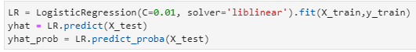
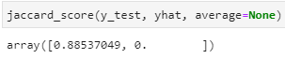
Analysis (model building)
First, the data is split into X (features / independent variable) and Y (target / dependent variable). Second, the data is encoded using the one-hot encoder. Finally, the dataset is split using a train-test-split function, with a composition of 30 percent test set and 70 percent training set.
Model Training
The Logistic Regression model is trained using the parameter C = 0.01, solver = 'liblinear’.
Model Evaluation
Jaccard Index
The Jaccard index, also known as Intersection over Union and the Jaccard similarity coefficient (originally given the French name coefficient de communauté by Paul Jaccard), is a statistic used for gauging the similarity and diversity of sample sets. The Jaccard coefficient measures similarity between finite sample sets, and is defined as the size of the intersection divided by the size of the union of the sample sets. The Jaccard distance, which measures dissimilarity between sample sets, is complementary to the Jaccard coefficient and is obtained by subtracting the Jaccard coefficient from 1, or, equivalently, by dividing the difference of the sizes of the union and the intersection of two sets by the size of the union.
Jaccard similarity score in this project is 0.88. It's a relatively high result.
16

Slide 17
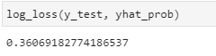
Analysis (model building)
Log Loss
In machine learning and mathematical optimization, loss functions for classification are computationally feasible loss functions representing the price paid for inaccuracy of predictions in classification problems (problems of identifying which category a particular observation belongs to). Log loss( Logarithmic loss) measures the performance of a classifier where the predicted output is a probability value between 0 and 1. Wikipedia
Log loss score in this project is 0.36. It's a relatively low result.
Classification Report
The classification report builds a text report showing the main classification metrics.
Precision is a measure of the accuracy provided that a class label has been predicted. It is defined by: precision = TP / (TP + FP)
Recall is true positive rate. It is defined as: Recall = TP / (TP + FN)
F1 score: Now we are in the position to calculate the F1 scores for each label based on the precision and recall of that label. The F1 score is the harmonic average of the precision and recall, where an F1 score reaches its best value at 1 (perfect precision and recall) and worst at 0. It is a good way to show that a classifer has a good value for both recall and precision. Wikipedia
In this report, the precision for 'Injury Collision' Class is 0.89 (89 percent). It means when the model predicts 100 times 'Injury Collision', only 89 prediction is correct. But, the precision for 'Property Damage Only Collision' class is 0 (zero). It means the model always gets wrong when predicts 'Property Damage Only Collision' class. Recall for 'Injury Collision' Class is 1 (100 percent). It means when the model can predict all actual values in this class. On the other side, recall for 'Property Damage Only Collision' class is 0 (zero). It means the model can't predict actual values.
17

Slide 18
Analysis (model building)
Confusion Matrix
In the field of machine learning and specifically the problem of statistical classification, a confusion matrix, also known as an error matrix, is a specific table layout that allows visualization of the performance of an algorithm, typically a supervised learning one (in unsupervised learning it is usually called a matching matrix). Each row of the matrix represents the instances in a predicted class while each column represents the instances in an actual class (or vice versa). The name stems from the fact that it makes it easy to see if the system is confusing two classes (i.e. commonly mislabeling one as another).
It is a special kind of contingency table, with two dimensions ("actual" and "predicted"), and identical sets of "classes" in both dimensions (each combination of dimension and class is a variable in the contingency table).
In the confusion matrix below, we can see a TP of 1398. It means that the entire class (0) 'Injury Collision' can be predicted entirely. However, the 181 'Property Damage Only Collision' class are predicted to be 'Injury Collision' (False Positive).
18

Slide 19
Analysis
Time and condition with high probability of injury collision
One of the advantages of using Logistic Regression is that we can get probabilities from predictions. This probability we can merge with the initial dataset. Thus, we can analyze times and conditions which have high or low probability. A new column is added to the dataset with the name 'Injury_Proba'.
Because the precision and recall scores for ‘Injury Collision’ are very high, the filtered dataset only displays this class. Besides, the precision and recall scores for the ‘Property Damage Only Collision’ class are also very low or zero.
This filter will also support analyzing what time and conditions on a low and high probability of an injury collision.
19

Slide 20
Analysis
The Safest Time for Cycling Activities
What is the safest month to host a cycling event?
The months with the lowest 'injury collision' probability are December, January, and November. These months have a low injury collision probability.
What is the safest day and weather to host a cycling event in December?
The days with the lowest ‘injury collision’ probability are Friday, Sunday, and Tuesday. The weather with the lowest ‘injury collision’ probability is Blowing Sand/Dirt. These times conditions have a low injury collision probability.
What is the safest day and weather to host a cycling event in January?
The days with the lowest ‘injury collision’ probability are Saturday, Friday, and Monday. The weather with the lowest ‘injury collision’ probability is Blowing Sand/Dirt. These times conditions have a low injury collision probability.
20

Slide 21
Analysis
What is the safest day to host a cycling event in November?
The days with the lowest 'injury collision' probability are Friday, Tuesday, and Monday. The weather with the lowest 'injury collision' probability is Snowing. These times conditions have a low injury collision probability.
The Most Dangerous Location for Cycling Activities
What are the most dangerous light and road conditions in Block Area for cycling activities?
The road condition with the highest ‘injury collision’ probability in Block Area is Dry condition. The light condition with the highest ‘injury collision’ probability in Block Area is Daylight condition. These location conditions have a high injury collision probability.
21

Slide 22
Analysis
What are the most dangerous light and road conditions in Intersection Area for cycling activities?
The road condition with the highest ‘injury collision’ probability in Intersection Area is Ice condition. The light condition with the highest ‘injury collision’ probability in Intersection Area is Daylight condition. These location conditions have a high injury collision probability.
Most Dangerous Locations Map for Cyclist in Seattle
The map below shows the most dangerous locations for cyclists in Seattle. The location points shown below have an 'injury collision' probability of above 90 per cent. Event organizers need to be careful at this location. Before the event starts, the committee needs to monitor the road conditions around that spot. If it is dangerous, the committee can repair it or give a unique sign to be more careful.
22

Slide 23
Results and Discussion
The results of this research can be used by organizers to intelligently plan cycling activities. They can take into account the safest times and the most dangerous places, where the risk of injury is extremely high.
The safest months for events are December, January and November. During these months, the average likelihood of injury in the event of an accident is lowest compared to other months. In December, the safest days are Friday, Saturday and Tuesday. The safest weather conditions this month are sand / dirt. January - Saturday, Friday and Monday, with sand / dirt weather conditions. November - Friday, Tuesday and Monday. However, with weather conditions it is snowing.
In addition to time and weather conditions, it is necessary to consider the list of the most dangerous places. These are the locations where the likelihood of injury is highest in the event of an accident. The most dangerous conditions for the block area are dry road conditions and daylight. The most dangerous conditions for an intersection are ice and daylight.
23

Slide 24
Conclusion
The safest months for cycling events are December, January and November. The safest day of the week is Friday. Despite daylight, organizers must be wary of dry and icy road conditions.
This dataset has limitations both in quality and quantity. If the class 'property damage only collision' is added, the precision and recall will increase.
Event organizers must work with the Seattle Department of Transportation (SDOT) to ensure cycling activities are safe with the best times and routes.
24

Slide 25

Thank you!
I would like to express my deep gratitude to the IBM team who made this project possible.
Best regards,
Michael Rusin

